Slide 1


Slide 2
TESTING THE EFFECTS OF AN ARTS-MAKING PROGRAM FOR KENYAN ADOLESCENTS
REPORT BY: KALORI WESONGA(WES) AND ROSINE BASEKE
PRESENTATION BY: KALORI WESONGA

Slide 3


Introduction
Depression and Anxiety symptoms account for 45% of the global disease burden for mental health in adolescents aged 13-19 years
Psychosocial variables and academic performance affect the severity of depression and anxiety symptoms.
1 in 2 Kenyan adolescent report clinical depression and anxiety

Slide 4

OBJECTIVES
TO EXPLORE THE EFFECTS OF AN ARTS- MAKING PROGRAM ON KENYAN ADOLESCENTS

Slide 5
MEASURES
PHQ-8: Measures depressive symptoms
GAD-7: anxiety symptoms

Slide 6
PROGRAM FEEDBACK
WE ASKED THEM 3 QUESTIONS:
What is your favorite part of the Program?
What would you like to change about the Program?
Do you have any other comments about the Program?

Slide 7
METHOD
Sample: 12-19 years old, Elite School- Kibera .
Described the research. Acquired Informed assent/consent by student participant and administrator.
Questionnaires were filled by participants. For this study, qualitative data was collected at endpoint.
We used thematic analysis to identify themes in the data- 313 cells were evaluated for themes

Slide 8
RESULTS

Slide 9
THEIR FAVORITE PARTS ABOUT THE PROGRAM

Slide 10
ON WHAT TO CHANGE ABOUT THE PROGRAM

Slide 11
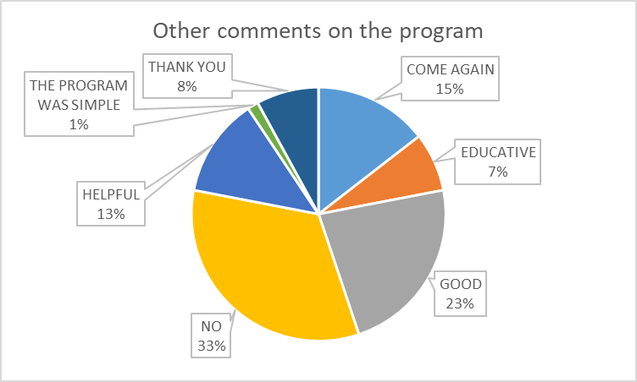
OTHER COMMENTS ON THE PROGRAM

Slide 12
TESTIMONIALS-
"This program can change the society, especially, Kibera.”
“I like the program simply because it has helped me in my academics. Sometimes I always feel lonely because I am asthmatic, but now am fine and I can mingle with friends.”

Slide 13
KEY TAKEAWAYS
Pretext needs exposure.
Pretext can be contextualized to suit the students needs. For example, use of African songs and stories.

Slide 14
LIMITATIONS OF PRETEXT
Literacy levels among slum dwelling students are low.
Many students have challenged cognitive abilities due .For example, through substance/drug abuse.

Slide 15
THANK YOU FOR YOUR TIME

